Slide 1
The Guardians of the GUI Present: The GotG MD System
Christina Reid
Sara Hakkoum
Thomas McNulty
Trevor Gorman

Slide 2
Contents
Introduction
GUI Design: A Focus on Panels
Behind the Scenes: Technical Backend
Conclusion
Questions & Appendices

Slide 3
Introduction
Purpose: Create a comprehensive record-keeping software for use in a general practice medical doctor’s office.
Project Requirements:
Supported by backend database.
Allow Doctors and Nurses to both use the system.
Achieve program security with user authentication.
Store information about patients, visits, lab orders, and prescriptions.
Create a highly functional, aesthetically pleasing GUI.

Slide 4
GUI Design: A Focus on Panels
We split our GUI up into a number of small panels.
Each panel has its own function in the program.
The program’s JFrame uses a CardLayout to swap between visible panels.
N
Y
Getting Started
Panel
Login Panel
valid
Search Panel
Register
Find patient,
New visit
Find visit,
Update visit
View Info
Register
User
Information Panel
Patient Information Panel
Visit Panel
Find patient,
Update patient

Slide 5
Login Panel
The Login Panel is the first page that the user encounters in the MD Systems.
Functionality
It asks for the user’s username and password.
Register button allows the creation of a new user account.
Security
Menu access is limited, so you can’t bypass the login screen.
Passwords are encrypted (hash & salt) for maximum security before being stored in the database.
Login panel validates login with stored credentials in database.

Slide 6
Getting Started Panel
“Home” panel for the program – Home buttons
Shortcut Navigation Menu:
User Information, Patient Registration, Search Records, and Create New Visit.
Recent Visits list
Shows last week’s worth of general practice visit records.
Displays patient name + date of visit in list.
Details of selected visits can be instantly brought up in the Visit panel by clicking the “View” button.
Once the user is logged in, the Main Menu dropdown list has additional menu options displayed for the user.

Slide 7
User Information Panel
This panel has two modes.
Registration
New users can enter information to create a new user account.
Minimum requirements: first name, last name, position, username, and password.
Logged in User Information
The currently logged in user uses this panel to access their account information from a link in the getting started panel.
The logged in user’s information can be updated and then saved to the database with the enter button.
This panel only has access to the current logged in user’s info.

Slide 8
Patient Information Panel
This panel has two modes.
Registration
Doctors and nurses can register a new patient here.
Accessible from Getting Started navigation menu, menu bar.
Requires all fields except for Address 2 to be filled out.
Patient Information
Doctors and nurses can view a patient’s information after searching for the patient or one of the patient’s visits.
Patient information can be updated and saved to the database with the submit button.

Slide 9
Search Panel
The Search Panel is where doctors and nurses can search for records by certain attributes.
Two types of search: Patient search and Visit search.
Searchable attributes:
Patient – first name, last name, birthdate, address, insurance#
Visit – doctor username, date, searchable attributes of patient
Searches return a list of records as results.
After selecting a Patient from the search results:
Doctors and nurses can view and edit that patient’s information.
Doctors can create a new visit record for that patient.
After selecting a Visit from the search results:
Doctors and nurses can view and edit existing visit records.

Slide 10
Visit Panel
The Visit Panel has multiple panels organized within a card layout, all of which contain information about a single general practice visit.
Each panel presents a specific section of medical information about this visit.
Patient Information, General Practice, lab tests, prescriptions, and nursing comments.
The Visit panel is used to:
Create a new Visit for a patient.
View information regarding an existing Visit.
Update information about an existing Visit.

Slide 11
Behind the Scenes: Technical Backend
DatabaseConnection
All of our database code isabstracted into the DatabaseConnection class, which serves method calls from the GUI classes.
PasswordEncryption
Password encryption and validation is all handled by the PasswordEncryption class.
MedicalConfigurator
Information is passed between different GUI panels by the MedicalConfigurator class.

Slide 12
Backend: Database Connection
We used the standard JDBC connector to connect to a remote MySQL server hosted on Amazon Web Services (AWS).
This means that two users of our program on different computers have access to the same database.
We designed strict database requirements before beginning work on our project.
Database Schema – What data do we need to record?
DbConn interface – What methods will our database connection need to make available for the GUI? (CRUD)
DbTest – A JUnit test class which verifies the functionality of all the methods defined in the DbConn interface.

Slide 13
Backend: Database Schema
patient
patient_id | first_name | last_name | birthdate | gender
address | address 2 | city | state | zipcode
country | insurance_ provider | insurance_ account_#
user
username | first_name | last_name | specialty
pager_number | position | password_salt | password_hash

Slide 14
Backend: Database Schema
visit_id | patient_id | doctor_id | date | field_a | field_b
field_c | field_d | field_e | field_f | field_g | comments
general_practice_visit
lab_order
lab_order_id | visit_id | lab_name
test_name | results | has_image
prescription
prescription_id | visit_id | medication_type
medication_name

Slide 15
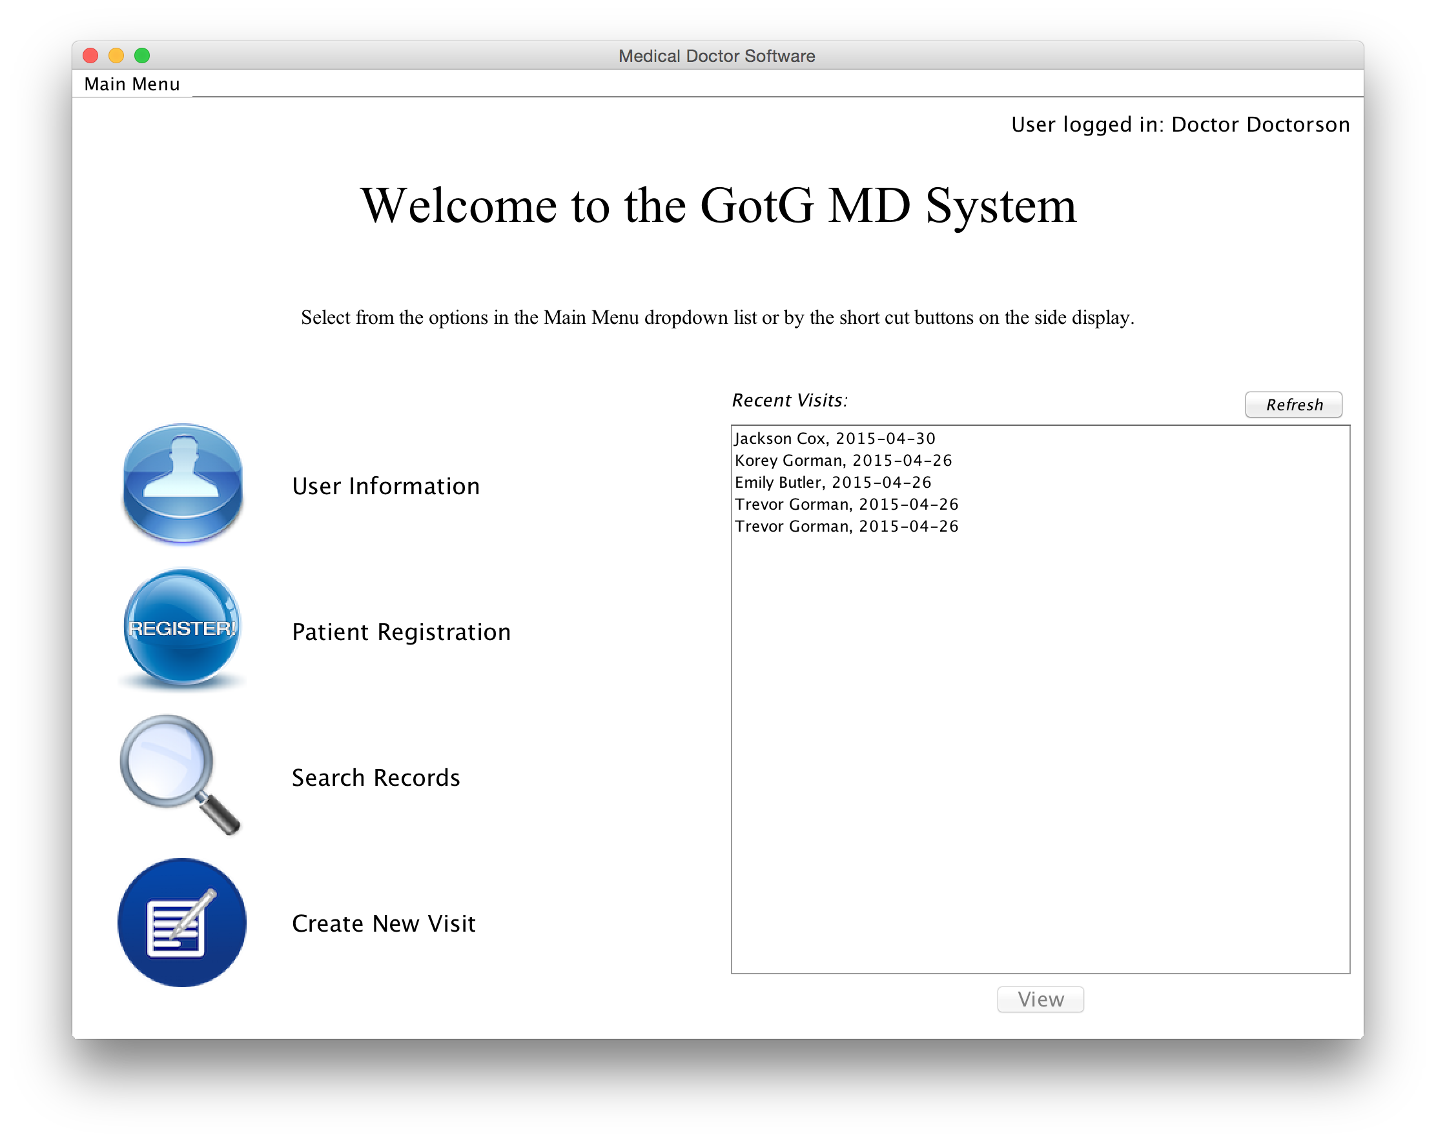
Demonstration

Slide 16
Future Work
Server-side program to handle transaction wrapping.
Website for patients to register themselves on.
Better compliance with Amazon Secret Key security standards (standalone key file instead of hardcoded key).
Database storage for additional types of records that a general practice office might need to track:
Supplies, meds, rooms, calendars, future appointments, etc.

Slide 17
Conclusion
Our local program has strong security, but we would need to improve server side security if we went to production with this project.
Our system meets all the goals we set out to accomplish – the GotG MD System is ready for the real world! (Maybe not quite ready…)

Slide 18
Questions?

Slide 19
Appendix - Github
We used Github to version our project and pull/push changes between our local repositories and a shared online repository.
Github made it easy for us to work on the project simultaneously without running into any major issues.

Slide 20
Appendix – Apache Maven
We used Maven to automate the build process for our project.
Maven compiles all of our source files, runs JUnit tests, and then packages the entire project into a .jar file.
Maven automatically pulls package dependencies for our project, notably the JUnit and AWS-SDK packages, and includes these dependencies in our packaged .jar file.

Slide 21
Appendix – JUnit Tests
We had two JUnit test files:
DbTest.java: Tests all methods of DatabaseConnection
S3Test.java: Tests all methods of S3ImageStorage
These allowed us to make changes to the database code, and immediately see if our changes broke any of the class' functions.
Maven automatically ran the tests whenever we compiled & packaged the project.

Slide 22
Appendix – Password Encryption
Passwords are hashed and salted for security.
User Registration Panel
java.security.SecureRandom
“username”
“password”
generates random salt string
“2cf24db...”
1. Salt the password:
“password2cf24db...”
javax.crypto.SecretKeyFactory
2. Hash the salted password:
GenerateSecret() - SHA1 Hashing algorithm
Hashed pw
“c05c68df...”
Username
Salt string
Hash string
3. Store into database:
“username”
“2cf24db...”
“c05c68df...”

Slide 23
Appendix – Password Encryption
Login password is validated against stored salt&hash.
User Login Panel
Username
Salt string
Hash string
2. Select user
from database:
“username”
“password”
“username”
“2cf24db...”
“c05c68df...”
1. Salt the password:
“password2cf24db...”
javax.crypto.SecretKeyFactory
3. Hash the salted password:
GenerateSecret() - SHA1 Hashing algorithm
Hashed pw
Stored Hash string
4. Check that salted + hashed password matches stored hash:
“c05c68df...”
“c05c68df...”

Slide 24
Appendix – AWS: RDS
Our database is hosted by Amazon Web Services on a Relational Database Service instance.
Our database requirements fell within the AWS Free Tier of usage, so the RDS instance is free.
The RDS instance is not a full server machine – RDS simply provides a running MYSQL instance which can be remotely connected to.
Our program is configured to connect to the RDS instance automatically when we establish a Database Connection.

Slide 25
Appendix – AWS: S3
We store images (for lab results) on an AWS S3 bucket.
S3 buckets are not traditional servers- they are pure cloud storage space, allowing us to upload and download files.
Amazon has documentation available with clear, simple examples of how to connect a program to their various AWS services.

Slide 26
Appendix – DbConn Interface
Interface for the database connection class to implement.
First file created in the project.
Defines all public methods of the database connection.
It let us define how the GUI would interact with the database before we started the project.
It is implemented by DatabaseConnection (a full implementation) and by DbConnDummy (a testing dummy).
This also allowed us to test the GUI side of the program before the database side was completed.

Slide 27
Appendix – MedicalConfigurator
The MedicalConfigurator class keeps track of active data in the GUI through static variables.
Logged in User
Active Patient record
Active Visit record
It also provides analysis methods for that data:
Has this record been stored in the database yet?
Are there images associated with this lab order?
etc.

